Slide 1
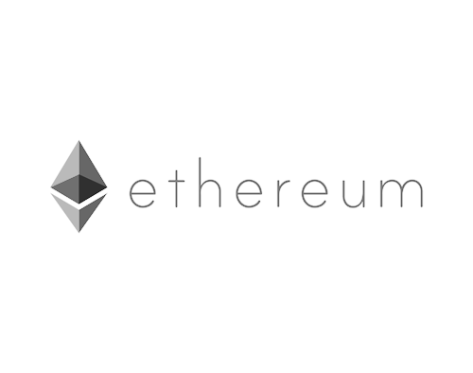

Distributed & Insured delivery smart contract
Students: Yonathan Haimovich and Yuval Kurtser
Supervisor: Alex Manuskin

Slide 2
Agenda
1
Ethereum smart contracts - Intro
2
Problem – Package tracking
3
System requirements
4
Solution
5
Design
6
UI & ABI
7
Operation example
8
Work environment

Slide 3
What is
Underlying crypto currency
EOA vs smart contracts
EVM
Notes:
An open-source, public, blockchain-based distributed computing
platform and operating system.
Transaction and payments are being done using underlying crypto
currency called “Ether”, ”Gas” units, and different abstraction “Tokens”
“A secure decentralized generalized
transaction ledger”
”Transactional singleton machine with
shared-state”
Transaction Are state-changing msgs
(function calls, funds transfer, etc.)
Two Account types:
EOA – Externally Owned Accounts
(controlled by humans or external code)
Smart contracts
(controlled by immutable code)

Slide 4
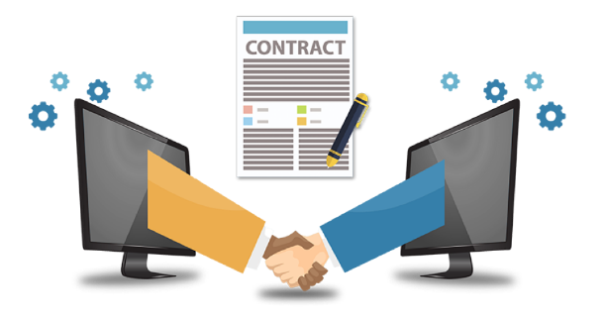
What are smart contracts?
A smart contract is a set of promises, specified in digital form,
including protocols within which the parties perform on these
promises — Nick Szabo, 1996
Smart contracts are Immutable-code based accounts on the Ethereum Block-chain.

Slide 5
What are smart contracts?
Each smart contract account holds:
Ether balance
Storage
EVM byte code and underlying Application Binary Interface (ABI)
Smart contracts can send transactions to other smart contracts and to EOAs, and deploy new contracts.

Slide 6
Package tracking
Global online retail sales are growing and are estimated to
reach 8.8% of total retail spending.
Billions of packages are being shipped around the world every year.
Every shipment involves built in risks for all parties involved, from the moment the package is shipped by the vendor, through delivery by the carrier, until it reaches the buyer

Slide 7
Risks
Lost/stolen package
Fraud
Dissatisfied clients
Multiple carriers
Notes:
Lost / stolen packages – package could get lost or stolen anywhere along its route, we wish to avoid losses and when it does happen agree on party who’s responsible for it.
Fraud- Online shopping scams involve scammers pretending to be legitimate online sellers, either with a fake website or a fake ad on a genuine retailer site. We wish to protect buyers from such scams
Unhappy client – package is returned to seller for some reason, double shipping.
Multiple carriers may have different systems for tracking, we want to provide all parties with an easy and transparent way to view most updated package status

Slide 8
Requirements
There is a need for a smart package tracking system that provides
solution for all the stakeholders in the shipment process, and will be:
Trustless
Deterministic
Secure
Easy to use
Affordable
Notes:
Trustlessness – terms of deal are agreed prior to shipping, all parties are protected from all risks mentioned.
Transparency - all parties have access to most updated package status at each time. In case of loss, we know who to blame
Security- data is immune to attack of unauthorized
Easy interface- all parties use the app the same way, no need to worry when package changes hands

Slide 9
Solution - Dapp
Decentralized Application (DApp) does not belong to a single provider or
server, but the whole stack are deployed and operated in a
distributed fashion on a peer-to-peer network.
It is a smart contract wrapped in a front end UI, that will provide users:
Resiliancy
Transperncy
Decetralization
Notes:
Resiliency: Having the business-logic written on a smart contract means that a DApp backend will be fully distributed and managed on the Blockchain. Unlike deploying an application on a centralized server, a DApp will have no downtime and will continue to persist as long as the Blockchain is still operating.
Transparency: The open source nature of a DApp allows anyone to fork the code and have the same application running on the Blockchain. On the same note, any interaction with the Blockchain will be stored forever and anyone with a copy of the Blockchain can gain access to it.
Censorship Resistance: As long as a user has access to an Ethereum node, the user will always be able to interact with a DApp without interference from a centralized control. No service provider, or even the owner of the smart contract, could alter the code once it is deployed on the network.

Slide 10
Solution - Dapp
A Dapp as described can meet all the requirements specified
Trustlessness
Transparency
Security
User friendly Interface
Notes:
Trustlessness – each party pays to contract agreed amount of ether. Terms are “agreed” by immutable code of the contract: in case of fraud – money will be returned to buyer, lost package – buyer get money back and seller gets shipping company deposit
Unhappy client -Package is returned to seller and client pays for delivery. If seller won’t sign it back - pkg goes to under dispute state, waiting for the dispute resolver to resolve the case.
Transparency - by the nature of ethereum
Security – built in the contract, only seller, client and shipper can sign a package
Easy interface – android app and Qrcode, user doesn’t have to understand blockchain

Slide 11
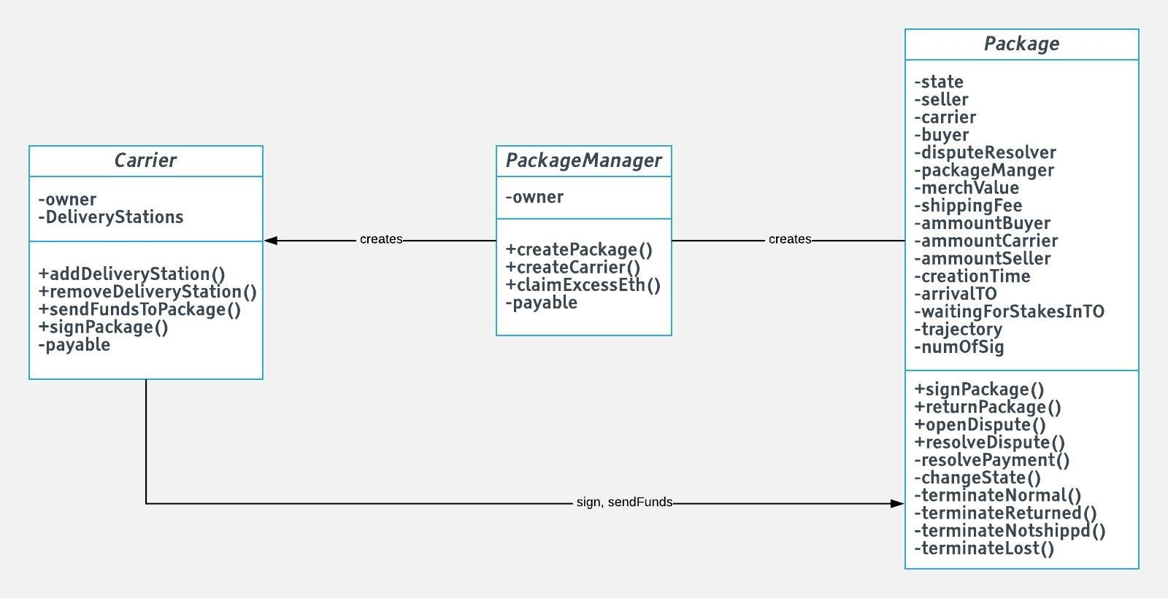
Design
Backend Design
Contract diagram
Backend Design
Backend Design

Slide 12
Contract: Package
Backend Design
Contains all necessary information of package
Public addresses of stake holders
Can be deployed by either party
Trajectory updated by signing
resolve payments

Slide 13
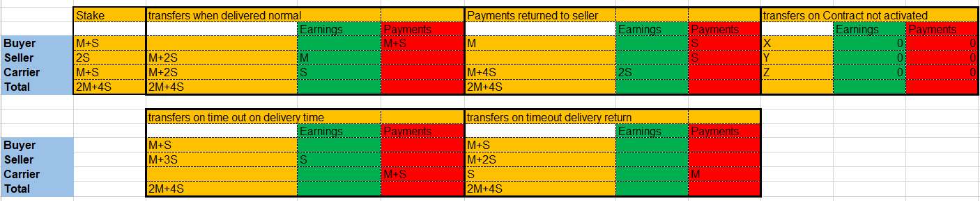
Contract terms
M = merchandise value
S = shipping fee

Slide 14
Contract diagram
Backend Design

Slide 15
Contract: Package Manager
Backend Design
main responsibility is to create a new package contract, when has all required information
Also creates delivery company contracts
Deployed once by us
Collects profit

Slide 16
Design
Backend Design
Contract diagram
Backend Design
Backend Design

Slide 17
Contract: Carrier Company
Backend Design
Provides another layer for secure access to package- a
proxy
Allows multiple signers/stations while keeping delivery company responsible, only owner will be able to sign package directly.
Easy to have multiple delivery companies with different policies, while keeping the same interface.

Slide 18
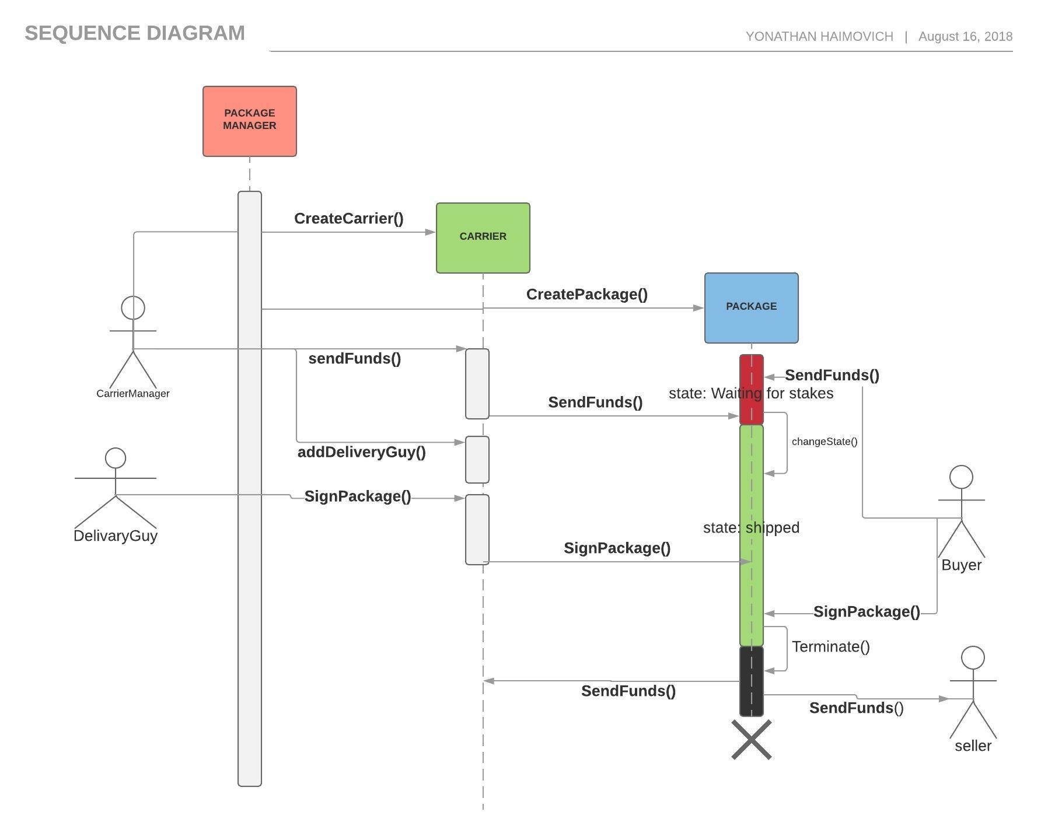
Sequence Diagram
Backend Design
Notes:
להסביר איזה פעולות א-סינכרוניות, איזה משנות מצב של הבלוקציין..

Slide 19
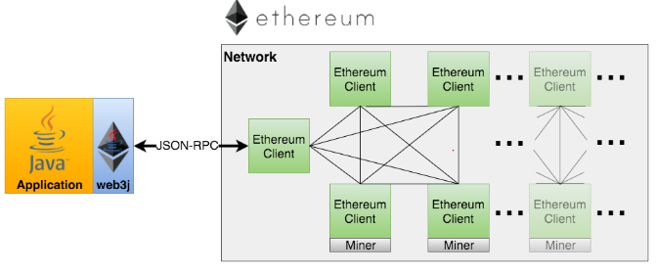
Front-Back end communication
BLOCK
CHAIN
SERVICES
Notes:
-סמארטפון לא יכול להריץ נוד
- אינפורה
איך נוצרים החוזים בג'אווה (adaptor)
דיפלויימנט ראשוני של packagemanager

Slide 20
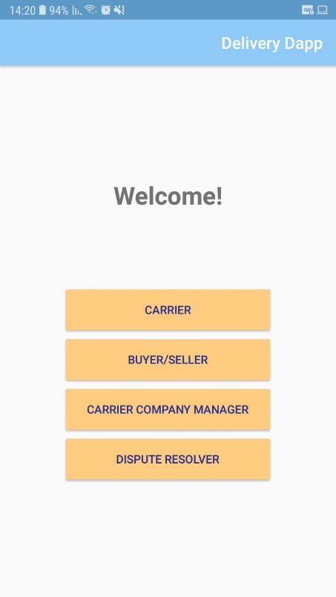
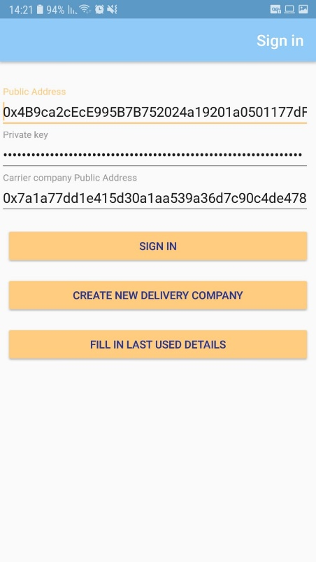
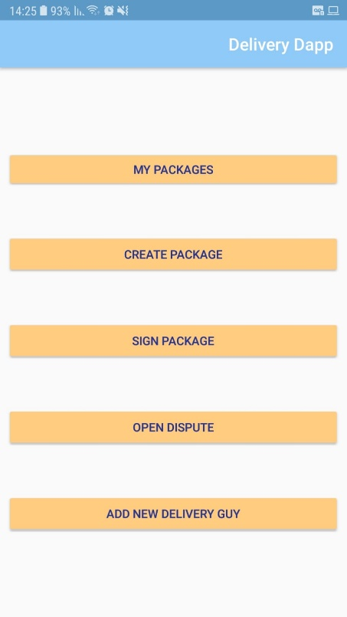
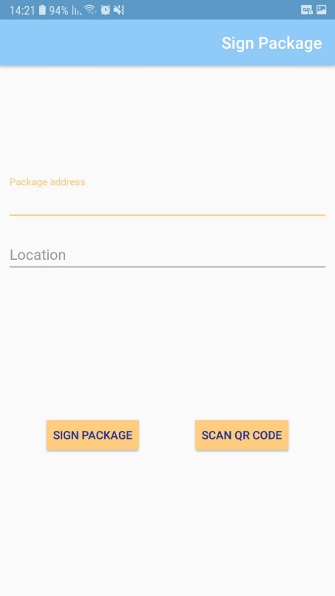
Android app – Example flow

Slide 21


Characterization
Development process
Design
Contracts implementation in Solidity
Deployment on Ganache
Web3 JS testing
Android app development
Deployment on Ropsten
Web3J
Dapp

Slide 22
Use Case - Demo

Slide 23
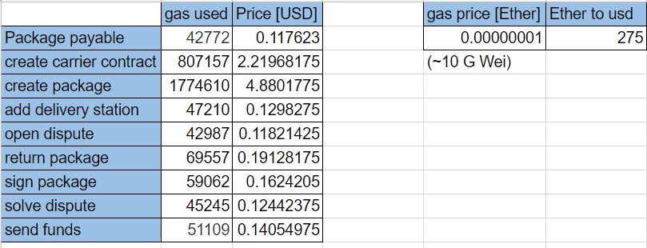
GAS cost

Slide 24
Conclusions
Limitations of a blockchain based app
Security issues
Strengths of smart contracts
Backend services expanses are paid by user
Notes:
להסביר איך כל פעולה ואחסון עולות כסף, מגבלות גז לבלוק, מה אפשר או אי אפשר לעשות ואיך לכתוב חוזה בצורה יעילה (איזה פעולות חייבות להיות בתוך הבלוקציין ואיזה בחרנו לשים בחוץ..)
זמן כרייה, אחסון node
בעיקר בתקשרות עם אינפורה אני מניח
בעיות שלא הצלחנו לפתור בחוזה, למשל אם המוכר מסרב לחתום אחרי החזרה, חבילה מגיעה אחרי הטיים אאוט..

Slide 25
Future work
Optimizing contracts to minimize costs.
Define different kinds of packages contracts – with different terms.

Slide 26
Questions
?

Slide 27
Thank you !

